Slide 1

Deliverable 4
Austre
Ethan Hendrix, Hitarth Patel

Slide 2
Table of Content
Introduction
Team Responsibilities
Design Document
Domain Model, Class Diagram, Sequence Diagram
Reflections
Demo

Slide 3
Introduction to Austre

Slide 4
Team Members
Hitarth Patel: Design, development, and deployment; Quality Assurance; Documentation
Ethan Hendrix: Design, development, and deployment; Testing; Documentation

Slide 5
Our Design

Slide 6
How it works
sudo python3 austre.py -na NET_ADDR -ip IP_ADDR -f FILENAME1 FILENAMEX
Scans for available IPs
Creates threads
Each thread:
Parses its given file to return array of data
Remaps IP addresses using online hosts
Sends remapped packets
Logs remapped packets to pcap
Informs user where to find their pcap logs
~/AuStdTrRp/austre_logs

Slide 7
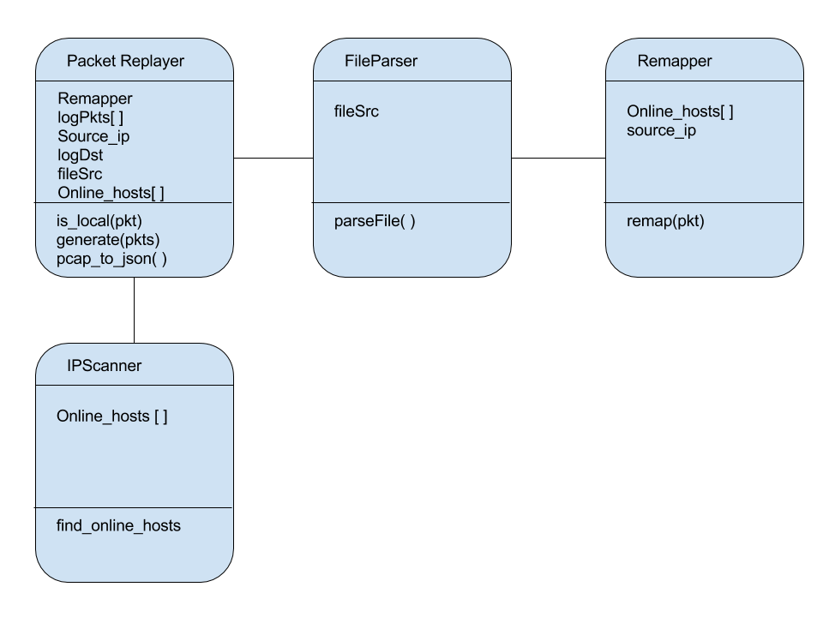
Class Diagram

Slide 8
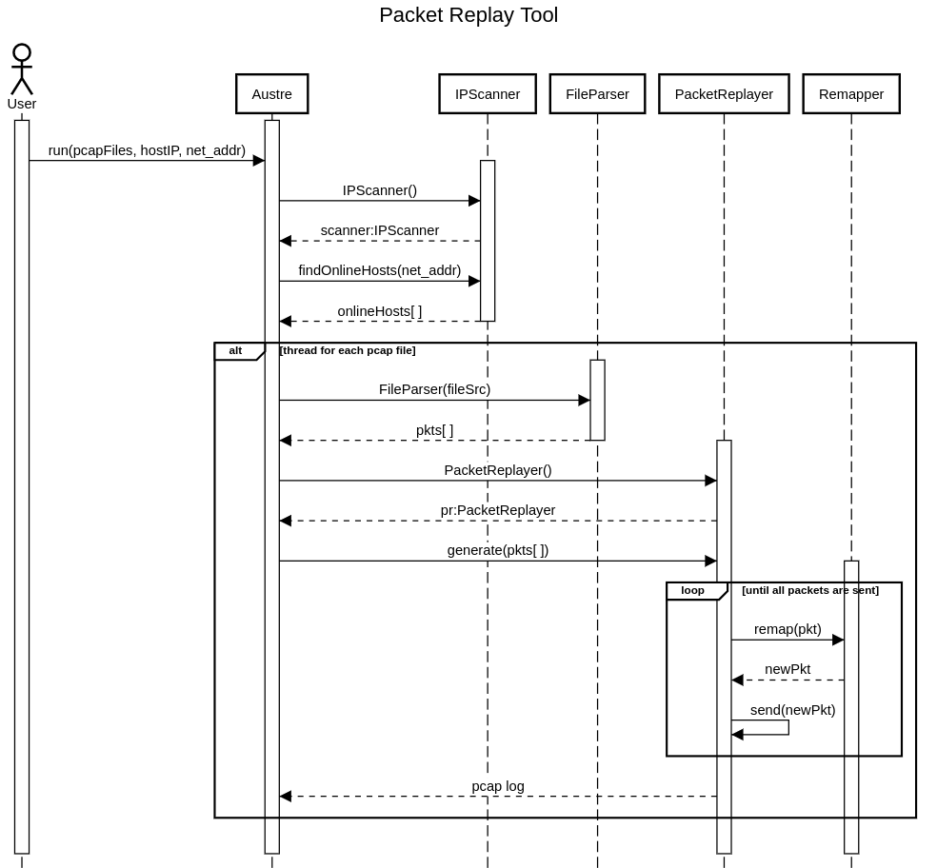
Sequence Diagram

Slide 9
Sequence Diagram cont.

Slide 10
Demonstration

Slide 11
Reflections
IP Address scanning implementation
Threading
Improvements for future iterations
Enhanced performance for IP Scanner
Multiple subnets
Detecting host IP automatically
Detecting network address automatically
Splitting a large pcap file into chunks to enhance tool performance
Further test different traffic patterns

Slide 12
Any Questions?

